Slide 1



Donor Retention & Fundraising Dashboard
View in Power BI
Last data refresh:
9/5/2026 11:55:57 AM UTC
Downloaded at:
9/28/2026 11:38:28 AM UTC

Slide 2
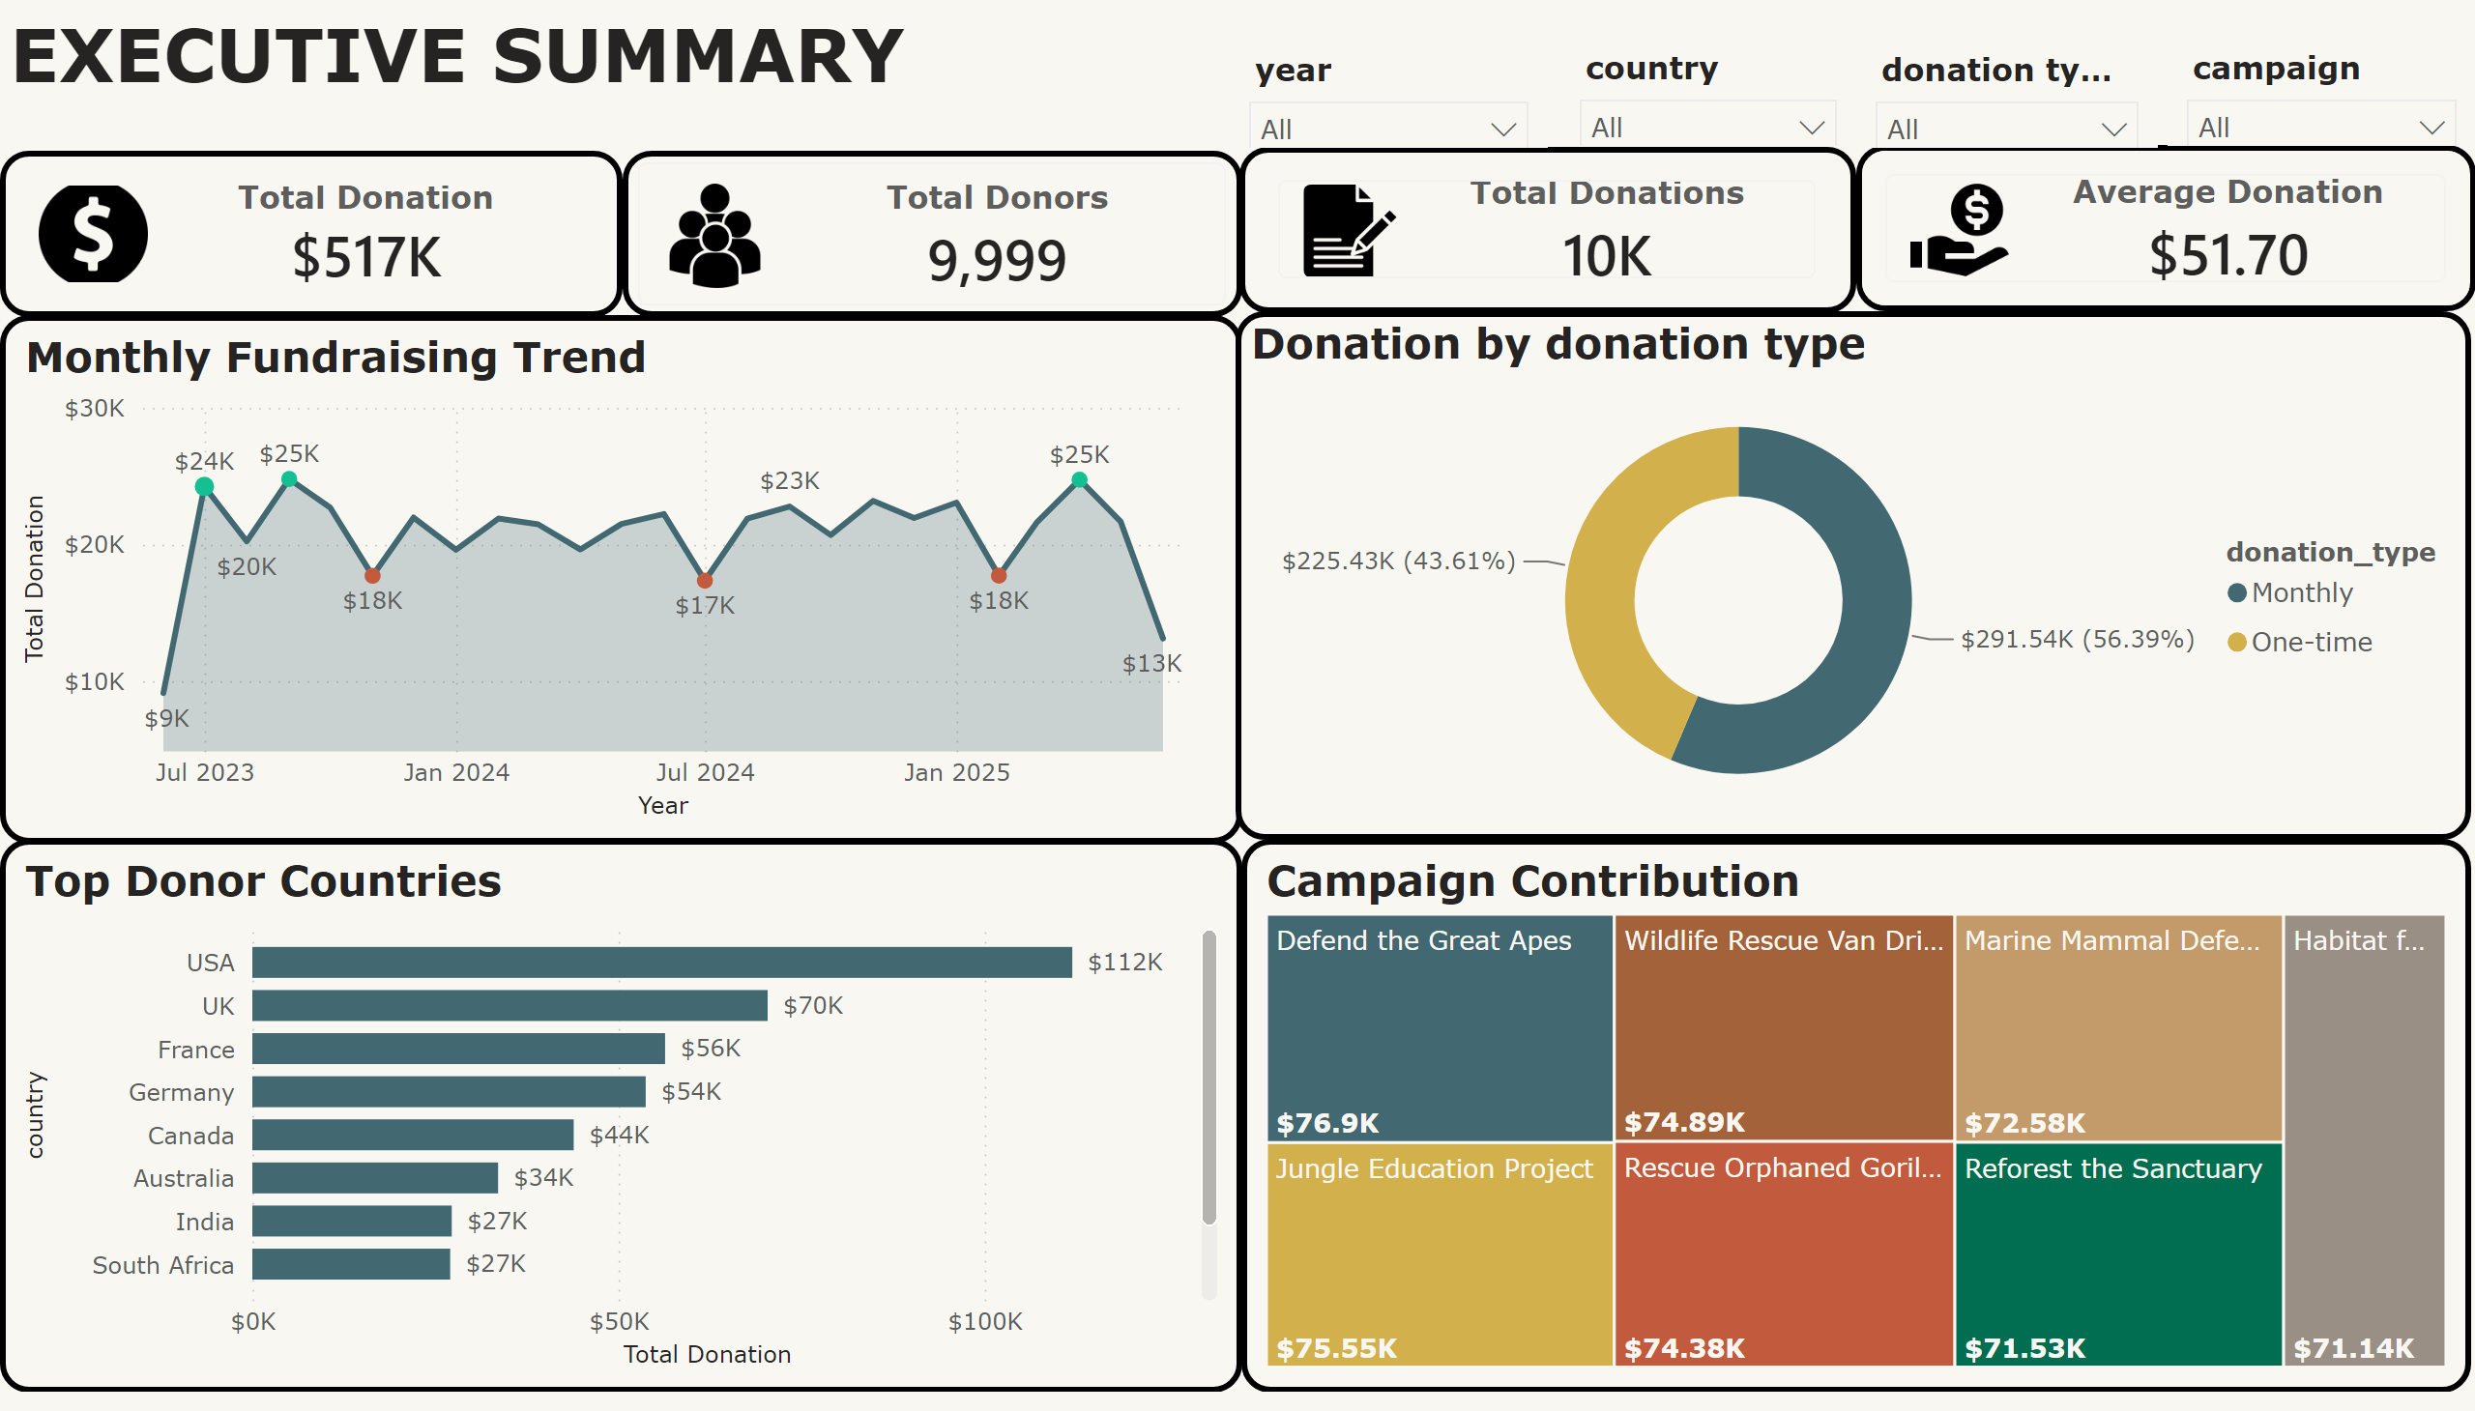
Executive Summary
Notes:
cardVisual
No alt text provided
cardVisual
No alt text provided
Top Donor Countries
No alt text provided
Monthly Fundraising Trend
No alt text provided
slicer
No alt text provided
slicer
No alt text provided
slicer
No alt text provided
Donation by donation type
No alt text provided
textbox
No alt text provided
cardVisual
No alt text provided
Campaign Contribution
No alt text provided
slicer
No alt text provided
cardVisual
No alt text provided

Slide 3
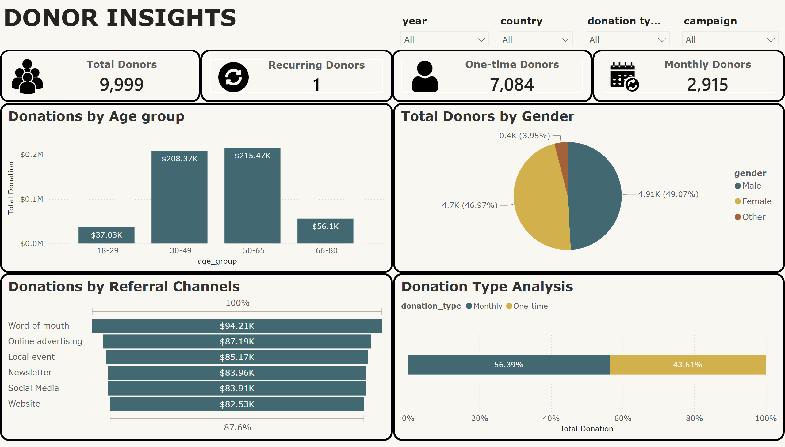
Donor Insights
Notes:
Donations by Age group
No alt text provided
slicer
No alt text provided
Donations by Referral Channels
No alt text provided
cardVisual
No alt text provided
cardVisual
No alt text provided
textbox
No alt text provided
cardVisual
No alt text provided
Donation Type Analysis
No alt text provided
slicer
No alt text provided
cardVisual
No alt text provided
Total Donors by Gender
No alt text provided
slicer
No alt text provided
slicer
No alt text provided

Slide 4
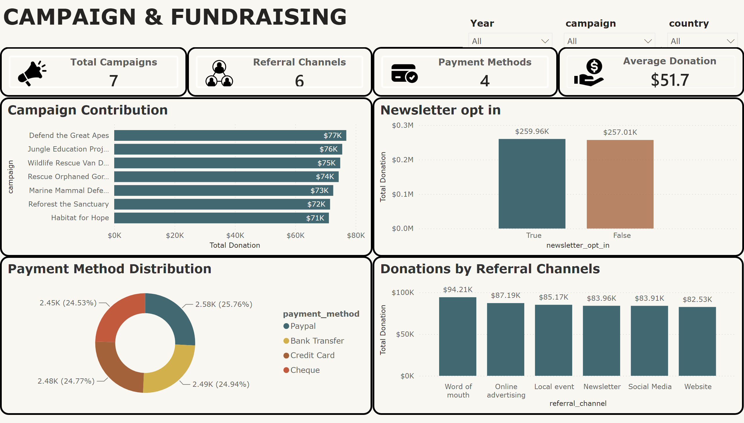
Campaign & Fundraisig
Notes:
cardVisual
No alt text provided
textbox
No alt text provided
Newsletter opt in
No alt text provided
Payment Method Distribution
No alt text provided
cardVisual
No alt text provided
Campaign Contribution
No alt text provided
cardVisual
No alt text provided
Donations by Referral Channels
No alt text provided
cardVisual
No alt text provided
slicer
No alt text provided
slicer
No alt text provided
slicer
No alt text provided

Slide 5
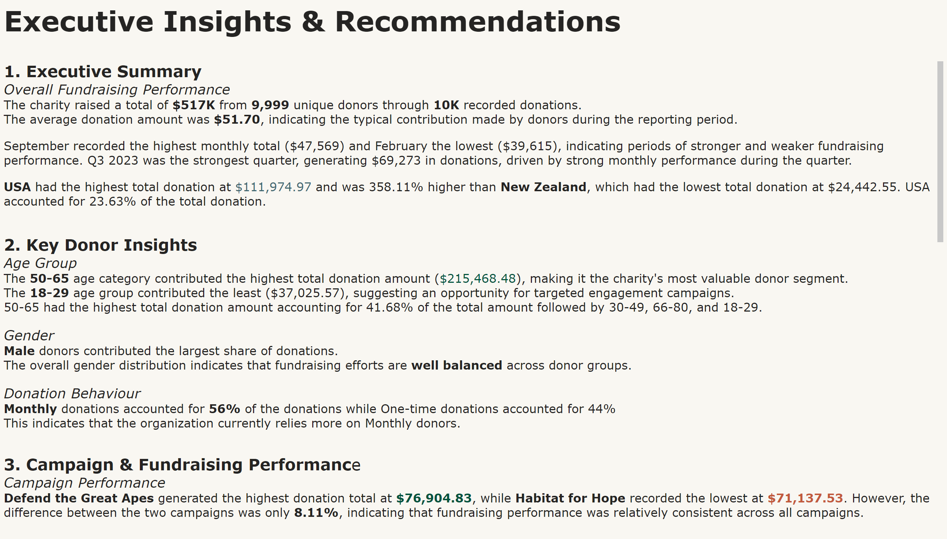
Summary & Recommendations
Notes:
textbox
No alt text provided
textbox
No alt text provided

